Slide 1



GetSetGo-Jek
Team Fantasticos
Keerthi Kumar N
Kanishk R
Vidya S

Slide 2





Scenario
You can find the restaurant that accepts orders on the go and TAKE AWAY as you walk along the way
You can get Perks when you land in a restaurant
You can connect to people who visited the same restaurant
You are able to recommend the hotel to your kith and Kin
You are able to locate on-going offers as soon as you enter a restaurant.
Dave is rushing to office and wants to have a quick bite and has no time to wait or sit and eat in the restaurant.

Slide 3

Why Take Away
354
million internet users
503
million internet users by 2017
160
Million raised by 31 food Startups in 2015
We Love Mobile Phones
Some Challenges –
Limited Delivery Time. Average is 30-45 mins
Demand Patterns vary as users order at different restaurants.
20-30 mins Traffic
10-15 mins preparation time

Slide 4
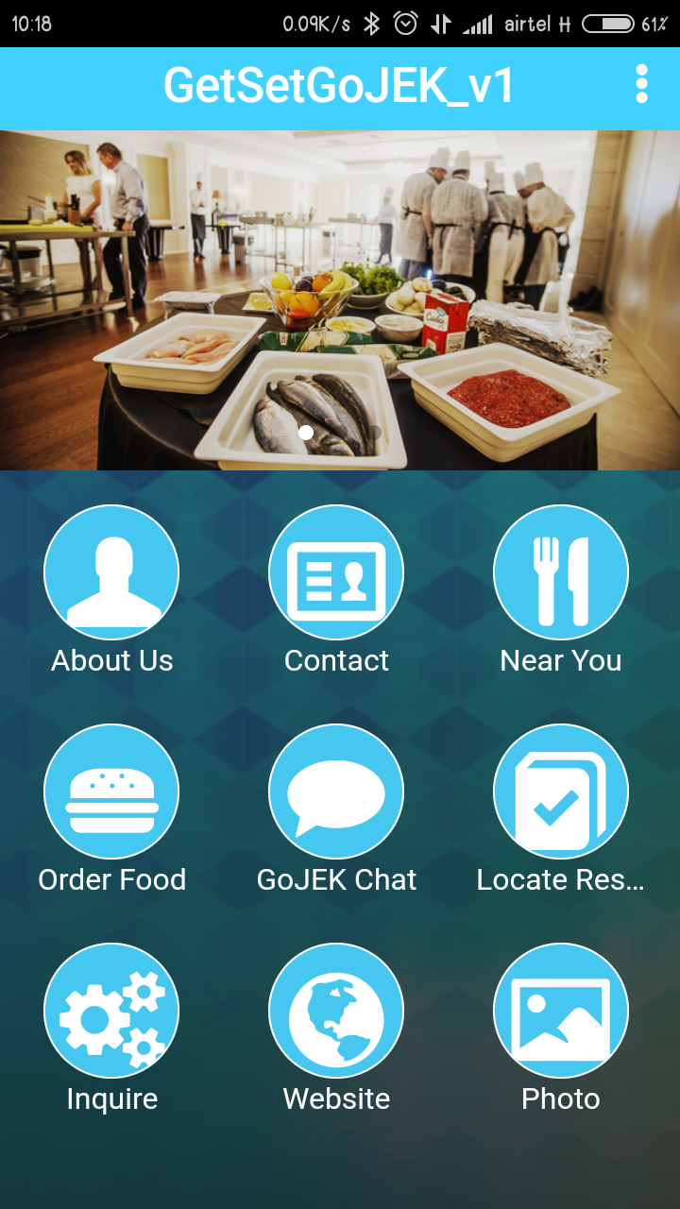
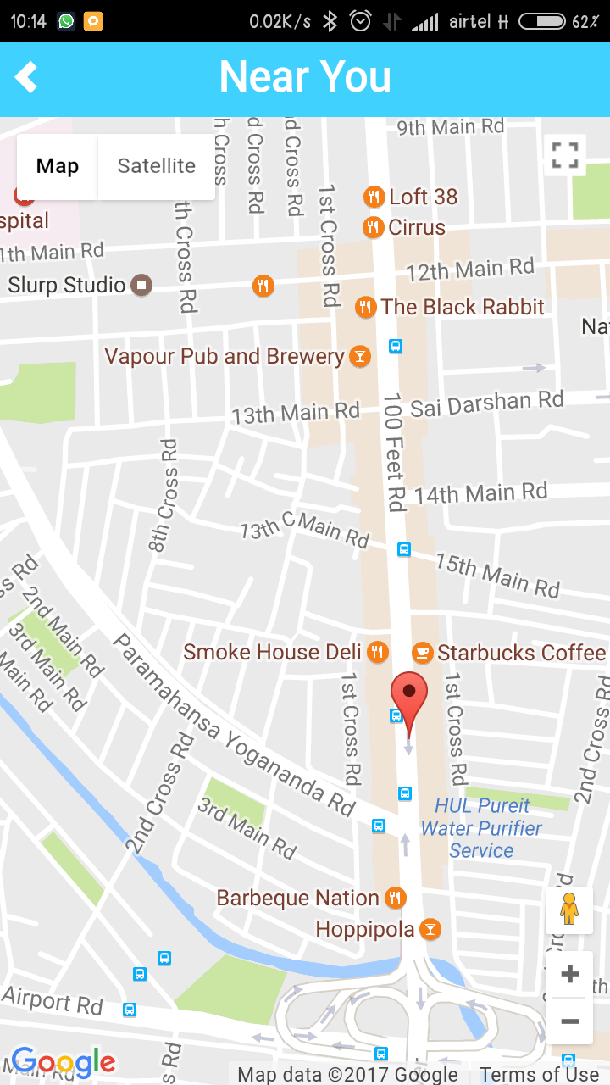
Take Away
Use the MAPS and GPS to locate Hotels Near you.

Slide 5
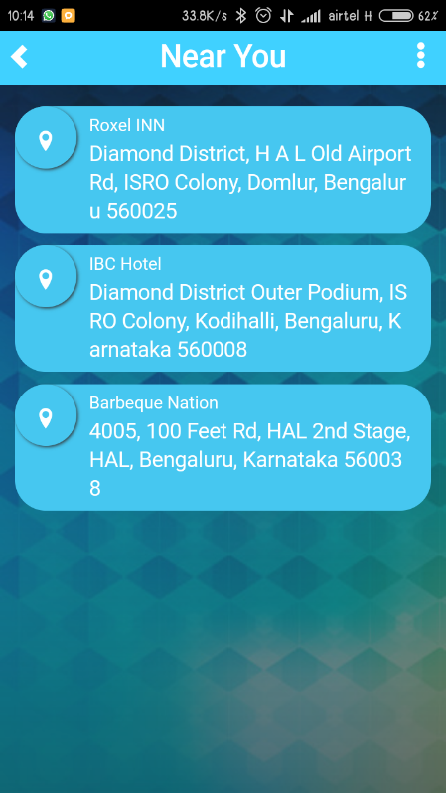
Take Away
Opt for one of the restaurant to book for Take Away
1 KM
700m
2 KM

Slide 6
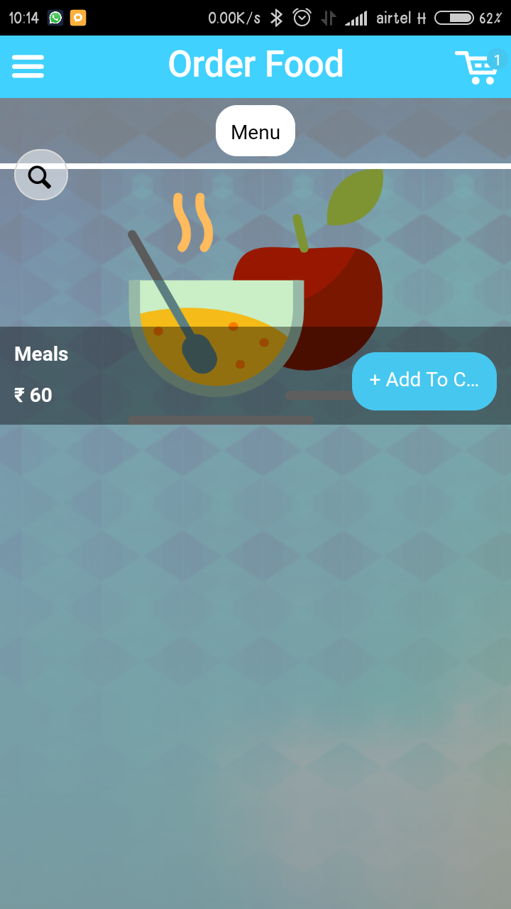
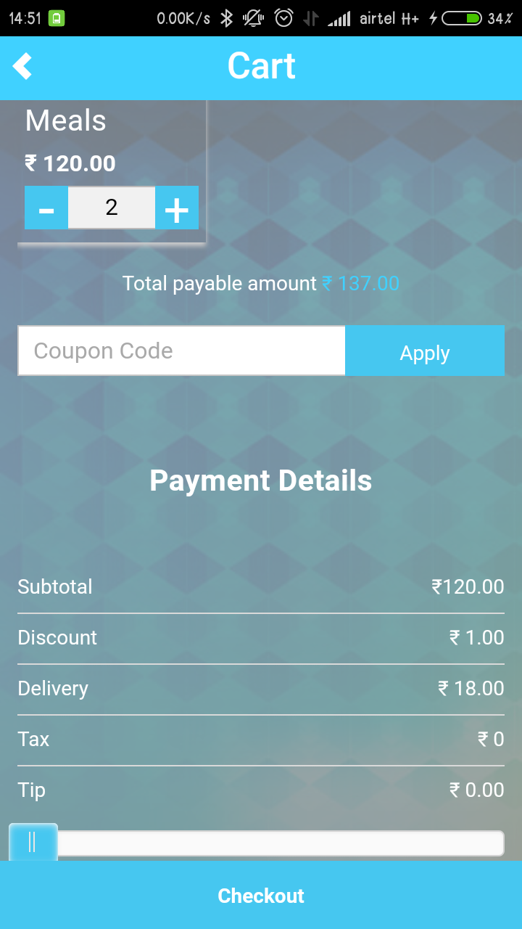
Take Away
1 KM
Order Food of your choice.
Payment Mode can be
COD
Card
Wallet
700m
Order Details sent via SMS to the registered mobile number
2 KM

Slide 7
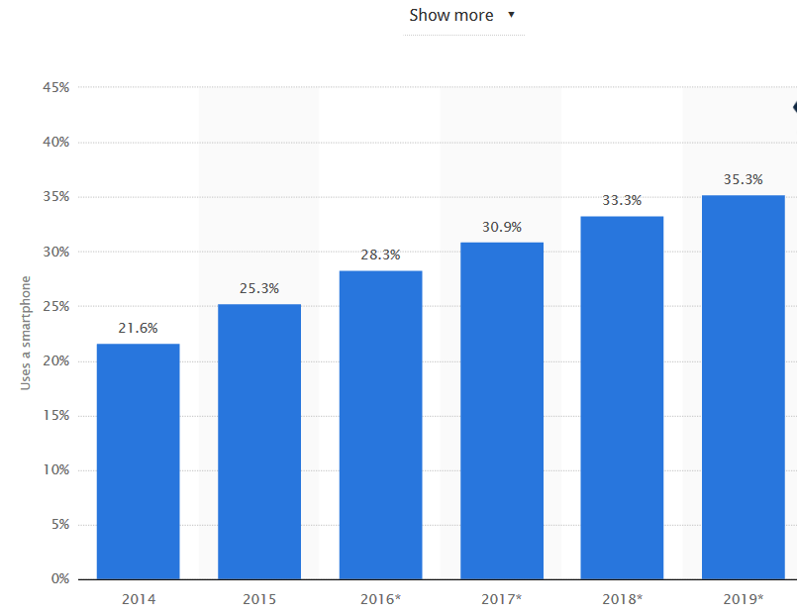
Why will the Idea Work !!
Recent surveys from Forbes says Millennials spend 44 percent of their food dollars eating out.
Food takeaway sales forecast to hit £8bn with smartphone boost
Takeaway food is benefiting from its positioning in between eating out and cooking at home.
The fast food industry in the United States generated approximately 198.9 billion U.S. dollars in 2014. By 2020, this figure was forecasted to exceed 223 billion.
More that 2 Billion Smart phone users in the world and rapidly increasing.

Slide 8

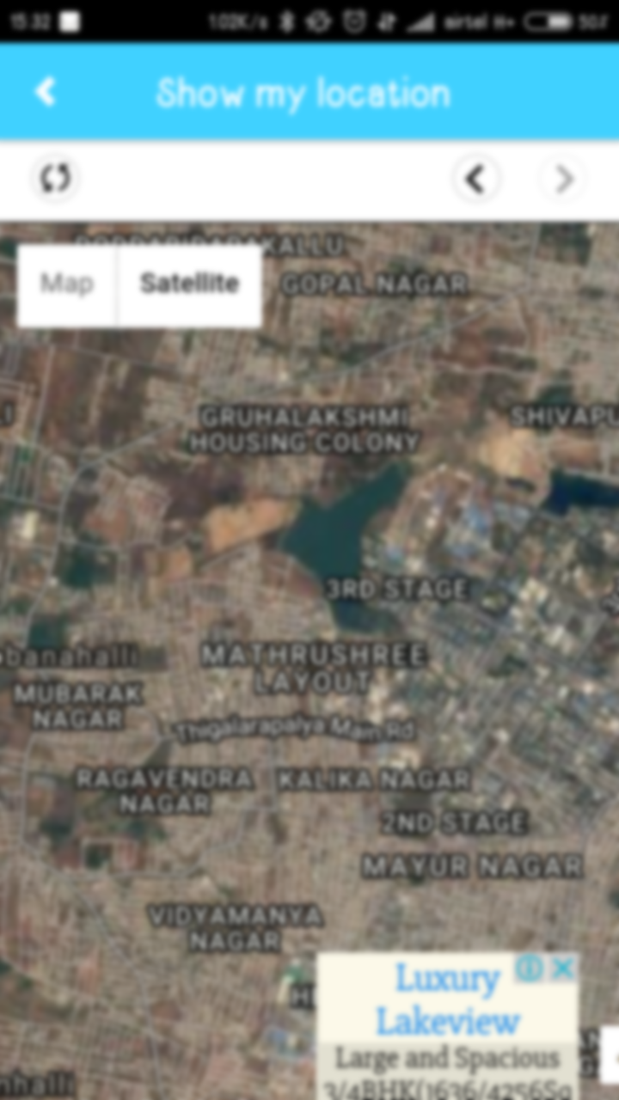

Perks (Loyalty points)
Locate the Nearby Restaurant on the App
Choose the restaurant
When the Customer enters the restaurant, allocate some perks in his account.
These perks can be reimbursed against any other services available in the App.
Since we know that the customer is going to make a purchase.

Slide 9
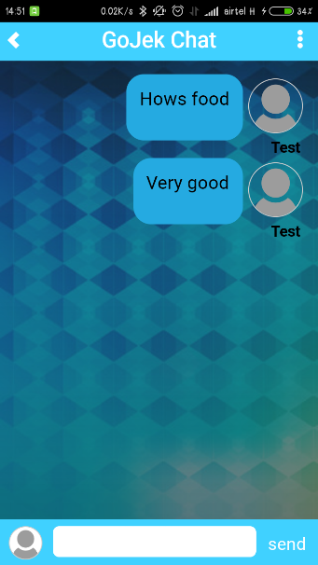




Connect to People
The application can show the list of people who visited the restaurant.
In case you want to check the type of food or the review, you can chat using the Chat application to the people nearby and know the review.
This also helps you socialize with others.

Slide 10
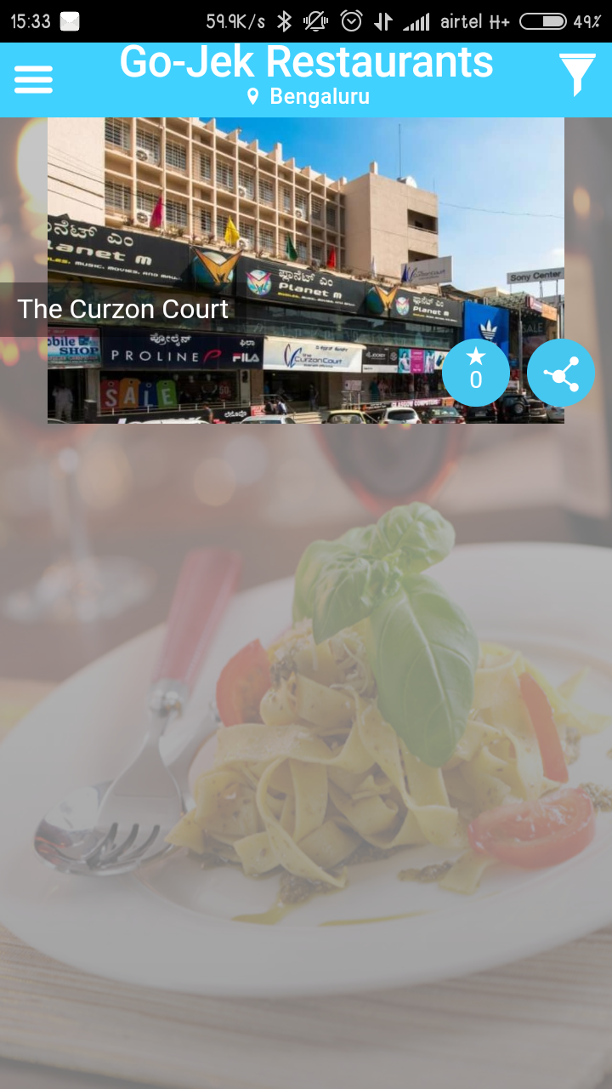


Recommendation / Fan Pages
Provide Options to Recommend the restaurant
Tag him / her, so that next time they come to the restaurant, the app automatically starts suggesting intelligently.
Add a Food as Favourite to recommend it to other customers to try.
RECOMMEND TO

Slide 11
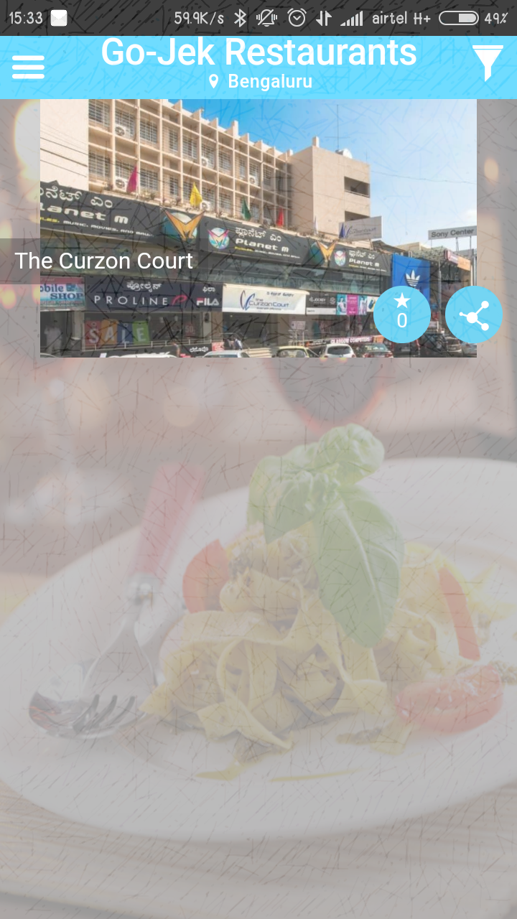
LOCATE OFFERS
When you enter the restaurant, quickly point out the offers before you get to hear or see around.
Suggest about the food they had last time (if they visited it before).
Point out the dishes that are popular and tagged as popular by guests.
Menu:
Dal Fry : 150
Salad : 200
Offers of the Day:
1 coke free with Biryani
50% off on buffet for second guest.

Slide 12
Thank You

